Slide 1



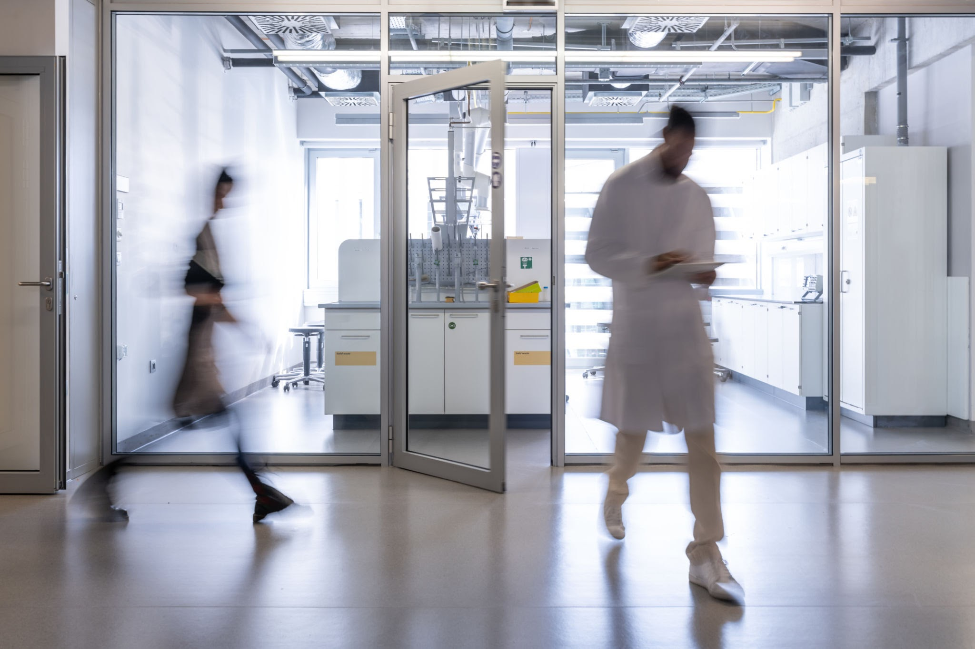
BUSINESS REPORT
Investing in a New In-House Microbrewery

Slide 2





Our Team

Slide 3

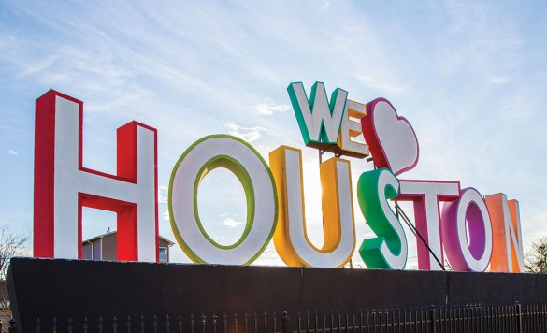
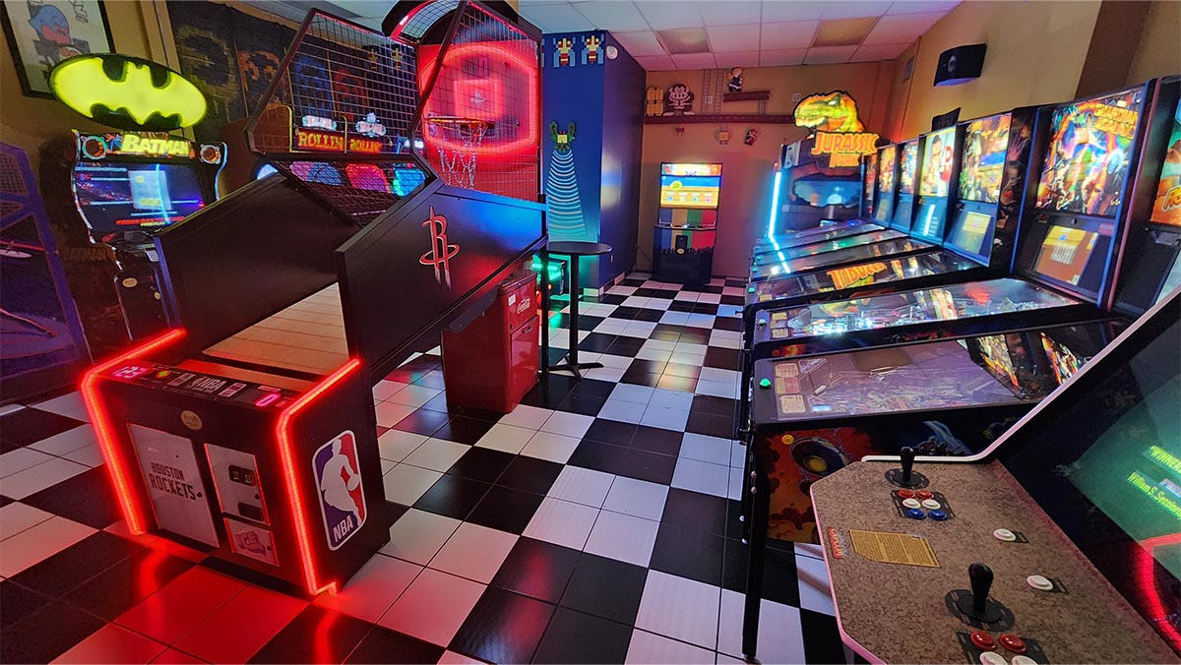
Overview
Our Mission
We strive to create a sustainable and profitable business that will foster a sense of community and inclusion.
Location: Houston, TX
Features:
uBrewery Patented System
Entertainment:
Arcade games
Pool Tables
Weekly Product Tastings

Slide 4
Assumptions
Assumptions Before the Cycles
Market Demographics and Conditions: Economic trends
Internal Factors: Financial health, resource availability, operational capacity.
External Influences: Regulatory changes, technological advancements
Selection of Input Parameters
Pricing Strategies: Adjust product/service pricing.
Marketing Strategies: Allocate budget across marketing channels.
Operational Adjustments: Modify production levels, staffing, supply chain logistics.
Financial Decisions: Implement cost-cutting measures, alter funding sources.
Tools for Analysis of Output Parameters
Financial Metrics: Profit margins and cost-benefit analysis.
Performance Indicators: Sales growth, market share, customer satisfaction, operational efficiency.
Notes:
Our assumptions for our microbrewery project were based on steady market demand for high-margin products like Bavarian Lager and Pilsner, stable cost structures, competitive pricing strategies, and a quick break-even point due to strong demand and efficient cost management. Analysis of the output parameters revealed consistent revenue growth, indicating successful market penetration and effective marketing strategies. The rising gross profit margins and steady increase in net profit reflect efficient cost management and strategic investments. Additionally, the decreasing ratio of fixed costs to total revenue and the reduction in management compensation as a percentage of total revenue suggest improved cost efficiency and a leaner management structure. Moving forward, we applied the AD715-BSIM by re-evaluating assumptions before each decision cycle, selecting key input parameters for adjustment, and using the simulator to analyse output parameters, ensuring continuous improvement in financial performance.

Slide 5

Takeaways
TTP 1
Add Specific Methodologies
Justify Pricing Strategy
Marketing management methodologies;
finance management methodologies
Average income; target customers
Improve Analysis Clarity
Ensure section
titles such as “Firm Value Chain” and “Core Competencies” are clearly labeled to avoid blending with the PESTEL analysis.

Slide 6

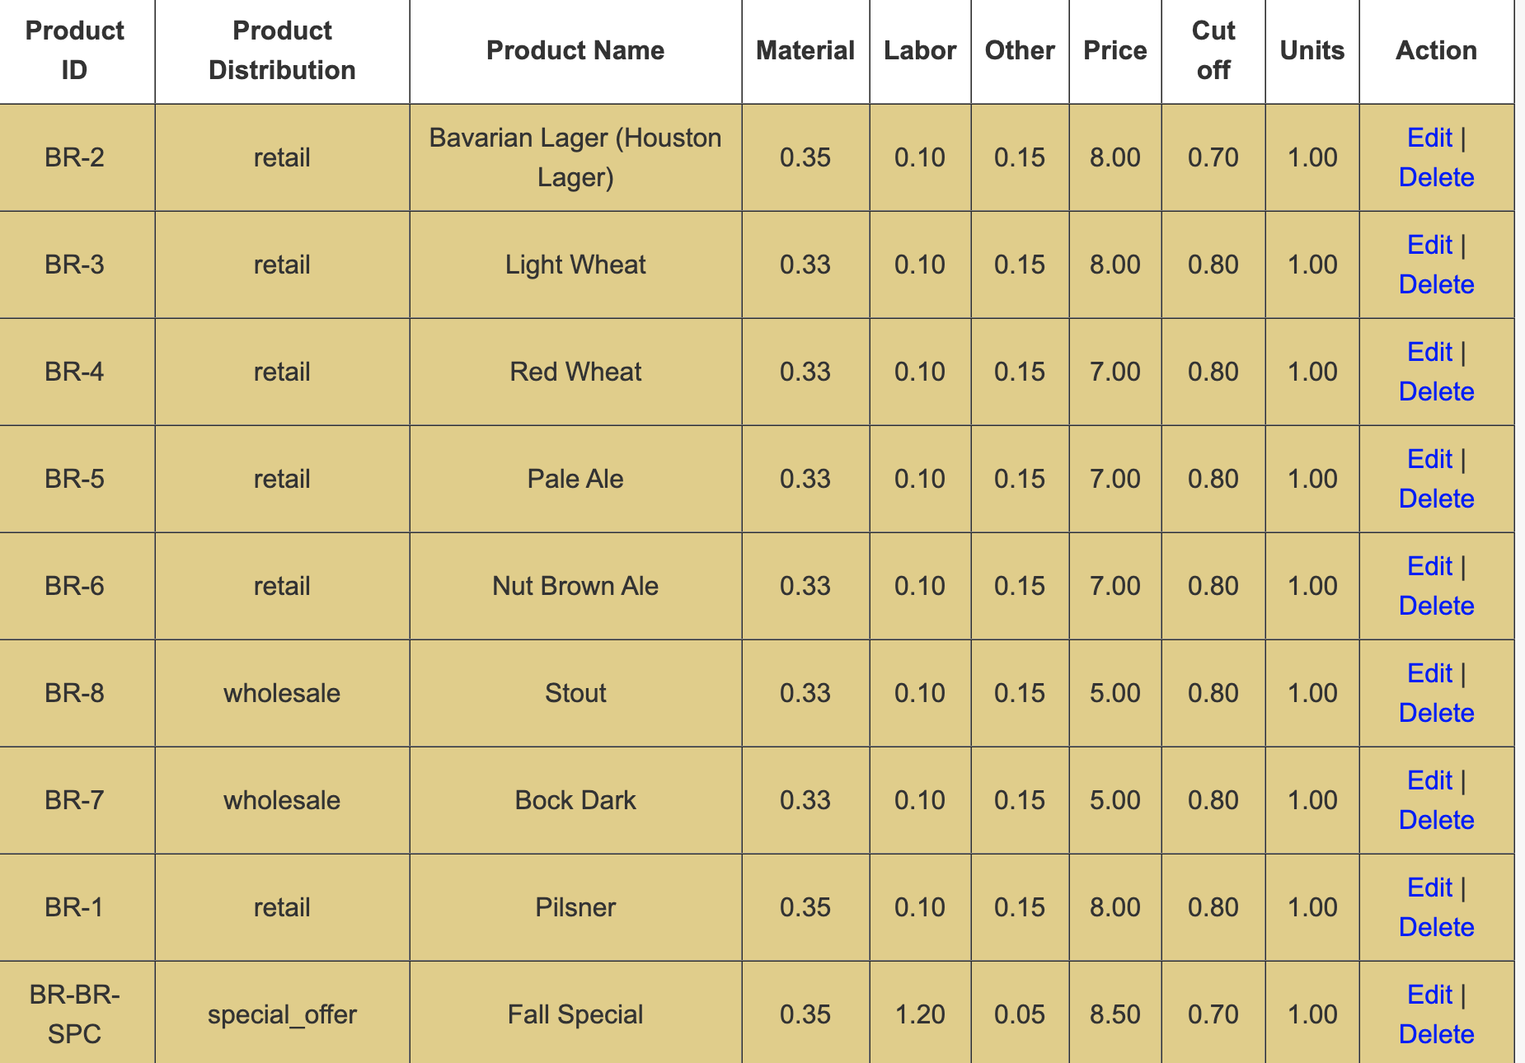
Operations Management Analysis
Retail price: $8
Wholesale price: $5
Market price in Huston: $7-$9; $4.5-$5.5
Peak retail demand: Summer months
Wholesale demand: Q1 and Q4
Material cost: $0.33-$0.35 per unit
Achieving profitability by FY-2
ROI FY-3: 15%

Slide 7
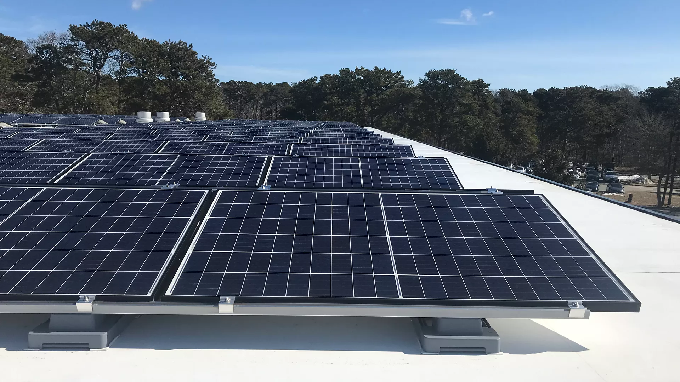
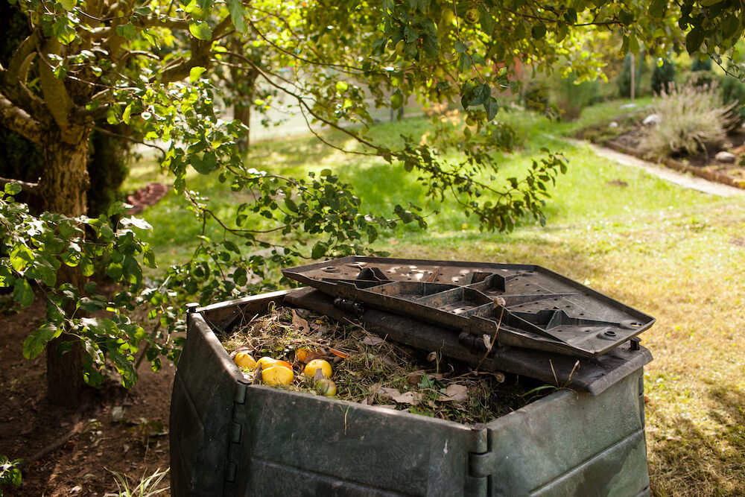
Innovation Management
Cycle 1 - Assumptions
Cycle 2 - Lessons Learned
costly
Utilizing rooftop solar panels can significantly compensate for electricity costs
On-site composting system provides financial savings through decreased reliance on third-party composting services
The balance between retail and wholesale production maximizes profit margins while maintaining scalability
Future innovations should focus on improving product lines based on contribution margin analysis to prioritize profitability
Adopting lean production techniques for high-volume, labor-intensive products can reduce costs and improve efficiency
not enough space
Scalability
Efficiency
Profitability
Notes:
Innovation played a key role in our analysis. Initially, we considered solutions such as rooftop solar panels to reduce energy costs and an on-site composting system to save on third-party services. While effective, these solutions were limited by cost and space constraints.
In Cycle 2, lessons learned highlighted the importance of balancing retail and wholesale production to maximize profits while maintaining scalability. Going forward, future innovations should focus on improving product lines using contribution margin analysis to prioritize profitability. In addition, the implementation of lean manufacturing techniques can significantly reduce the cost of labor-intensive products, improving efficiency.
Therefore, by aligning innovation strategies with key success drivers such as scalability, efficiency, and profitability, the microbrewery can achieve sustainable growth while addressing operational challenges.

Slide 8
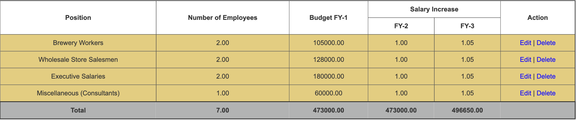
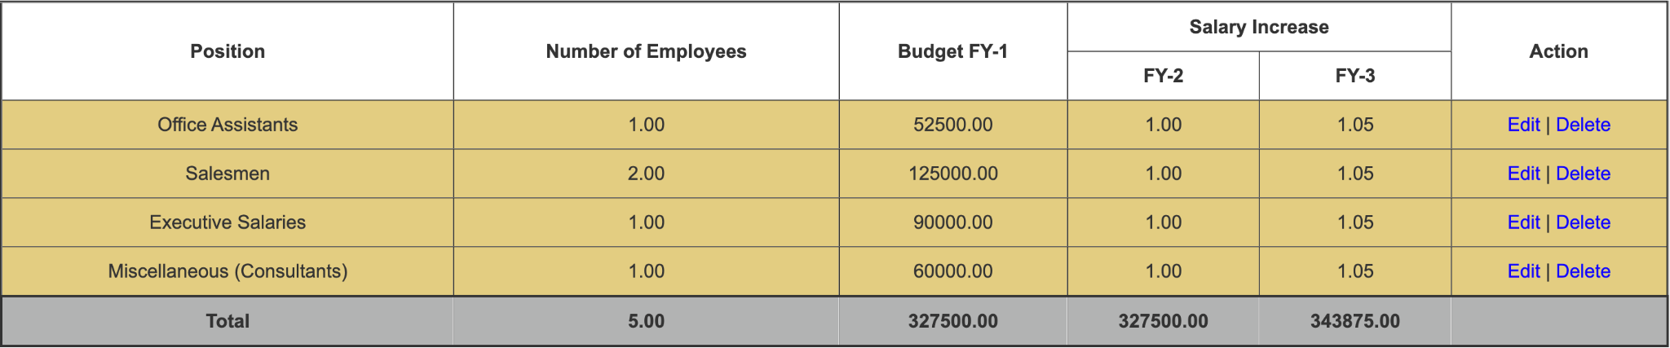
Organization & HR Management
Cycle 1
Cycle 2

Slide 9
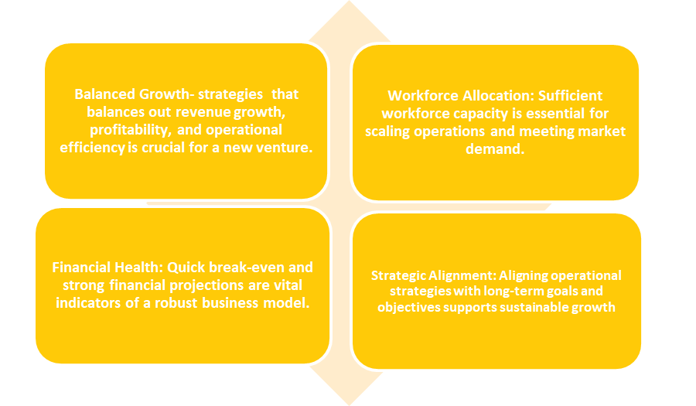
Key Lessons & Experiences from the Output Analysis
Notes:
Our microbrewery project has provided valuable insights and experiences. We observed a consistent increase in revenue, reflecting successful market penetration and effective marketing strategies, particularly through the introduction of new products and special offers. Efficient cost management and pricing strategies have led to rising gross profit margins, while a steady increase in net profit demonstrates effective financial management and strategic investments. The decreasing ratio of fixed costs to total revenue indicates improved cost efficiency. Additionally, the reduction in management compensation as a percentage of total revenue suggests a leaner management structure or performance-based compensation strategies. The success of Fall Special underscored the importance of staying responsive to market trends and customer feedback. Effective cost management, ongoing innovation, and technology investment were crucial for operational efficiency and product quality. Creating a positive work environment and implementing performance-based compensation strategies helped retain talent and boost performance. Overall, Cycle 1's balanced growth, strong financial health, and strategic alignment make it the best choice for launching our microbrewery in Houston

Slide 10

Strategic Decision Framework & Opportunities

Slide 11
Enhancing Microbrewery Operations
in Houston
Risk Assessment
Identifies and mitigates uncertainties for sustained growth.
Optimization Analysis
Maximizes resource allocation for production efficiency.
Break-Even Point Analysis
Establishes financial viability and prioritizes channels.
Decision Tree Analysis
Evaluates marketing strategies for optimal ROI.

Slide 12
Decision Tree Analysis
Strategizing Marketing Approaches
Digital Marketing
Outdoor Advertising &
Event Sponsorship
Strategic Recommendation
Anticipated success rate: 60%
Expected Monetary Value (EMV): $36,000
Platforms: Instagram, Facebook, Google Ads
Offers accurate targeting, real-time engagement, and measurable outcomes.
Effective for fostering community connection.
Lower EMVs compared to digital strategies, making them less cost-effective.
Enhance customer acquisition.
Build a strong brand presence.
Optimize budget allocation in line with market trends.

Slide 13


Break-Even Point Analysis
Determining Financial Viability
Key Metrics
Strategic Insights
Recommendation
Fixed Costs: $849,562/year (includes rent, salaries, utilities, marketing).
Contribution Margins:
Retail Products: $7.40/unit.
Break-even sales volume: 114,812 units.
Wholesale Products: $4.40/unit.
Break-even sales volume: 193,083 units.
Retail sales offer a faster route to profitability due to higher margins.
Retail channels enhance customer loyalty through direct interaction and feedback.
Wholesale expansion should follow break-even to diversify revenue streams and leverage economies of scale.
Prioritize retail channels during the initial operational phase to stabilize cash flows and achieve profitability faster.
Notes:
Objective
Establish the sales volume required to cover fixed and variable costs and achieve profitability.

Slide 14


Optimization Analysis
Enhancing Production Efficiency
Analysis and Allocation
Strategic Insights
Key Metrics
Recommendations
Retail demand is prioritized due to its higher contribution margin ($7.40/unit) compared to wholesale ($4.40/unit).
Remaining capacity (88,759 units) is allocated to wholesale to optimize profit potential.
Projected FY1 Profit: $3.29 million.
Employ dynamic production scheduling to respond to demand fluctuations effectively.
Continuously monitor market trends to optimize resource allocation and minimize waste.
Annual Production Capacity: 476,160 units.
Demand Projections for FY1:
Retail: 387,401 units.
Wholesale: 1,373,512 units.
Prioritize fulfilling retail demand to maximize profit margins and foster customer loyalty.
Use surplus capacity for wholesale output to diversify revenue streams and maintain operational flexibility.
Notes:
Objective
Maximize resource utilization and profitability by aligning production capacity with market demand.

Slide 15

Risk Assessment
Mitigation Strategies
Strategic Benefits
Key Risks Identified
Market Demand Fluctuations: Seasonal nature of craft beer consumption and economic downturns.
Cost Variability: Unpredictable raw material and labor costs.
Regulatory Compliance: Licensing, tax obligations, and potential regulatory changes.
Diversify Sales Channels: Expand beyond the Houston market to reduce dependency on local demand.
Dynamic Pricing & Loyalty Programs: Stabilize revenues during market shifts.
Long-Term Supplier Contracts: Mitigate raw material cost fluctuations.
Emergency Reserve Fund: Protect financial stability during supply chain disruptions or regulatory changes.
Strengthened financial resilience.
Enhanced operational continuity.
Increased capacity to adapt to market changes and seize new opportunities.
Notes:
Objective
Identify and mitigate risks to ensure the microbrewery's long-term stability and adaptability.

Slide 16


Key Lessons & Improvements
Lessons from Project 1:
Improvements in Project 2:
Marketing Precision: Specific focus on Instagram, Facebook, and seasonal promotions.
Data-Driven Pricing: $8 retail and $5 wholesale aligned with $70K median income.
Operational Alignment: Seasonal production matched with peak demand cycles.
Clear Frameworks: Independent SWOT and PESTEL for actionable insights.
Strategies lacked precision and actionable insights.
Pricing and production not tailored to Houston’s demographics.
SWOT and PESTEL analysis blended, reducing clarity.

Slide 17



Results and Business Impact
Quantifiable Benefits:
Lessons Learned
Profitability: Achievable by FY2 with 15% ROI by FY3.
Market Competitiveness: Tailored pricing and unique value proposition.
Customer Loyalty: Enhanced through targeted digital engagement and community events.
Feedback integration improved precision and feasibility.
Collaboration drove innovation and operational efficiency.
Adaptability aligned strategies with market needs.

Slide 18
Recommendations
Results:
Retail provides high margins, enabling faster break-even
Digital marketing on Instagram & Facebook platforms
15% ROI => profitability by FY3
Decision Strategy:
Prioritize Retail sales
Invest in Digital Marketing
Incorporate Sustainability
Optimize Operations
Mitigate Risks
Investment Advice:
Based on financial and operational analysis, we do not recommend an investment of $150,000 at this stage as the projected returns and risk factors do not justify the capital expenditure requirement.
Notes:
Based on our analysis, we developed a clear set of recommendations for decision-making. The results show that prioritizing retail sales provides high margins to reach break-even faster, while digital marketing campaigns on platforms such as Instagram and Facebook are critical to reach the target audience. By applying these strategies, the microbrewery can expect to achieve a 15% ROI and reach profitability by the third fiscal year.
However, after careful financial and operational analysis, we do not recommend investing $150,000 at this stage. The projected returns and risk factors do not justify the capital expenditure required. Instead, a measured, data-driven, incremental approach to implementing these strategies would be more reasonable to ensure sustainability and success.

Slide 19


THANK YOU!

Slide 20
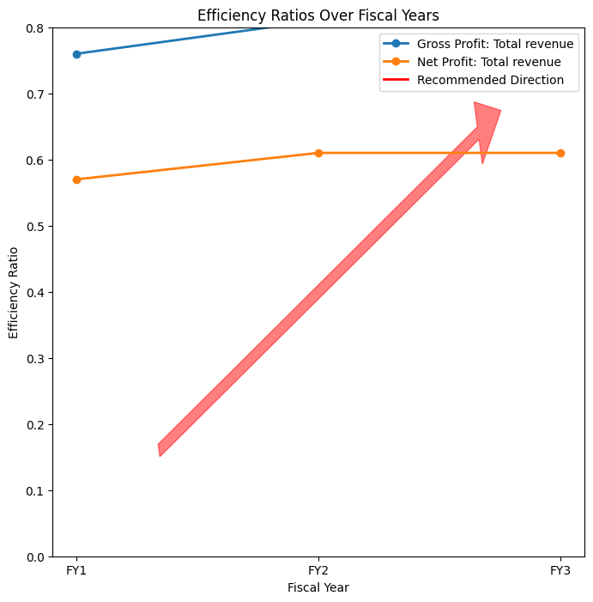
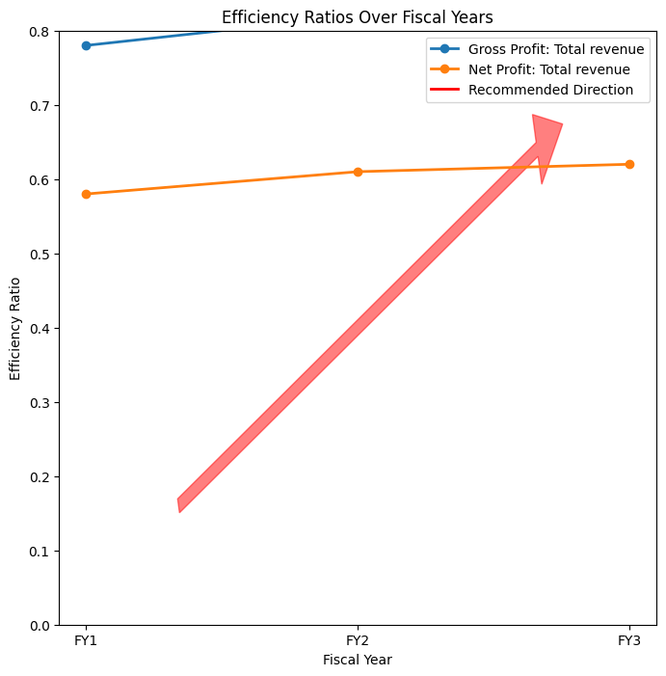
Cycle 1
Cycle 2
Profit Efficiency Ratio Plot

